Slide 1
Blood Donation System Final Project by Jay Nirmal
NuiD :- 1837557

Slide 2
PROBLEM STATEMENT
Many lives can be saved by donation of blood , if someone is met with a serious accident a blood donation camp nearby can save his/ her’s life.
This is a serious topic hence there is a requirement of a solid system without any glitches that can work in such demanding situations.
Blood donation will cost us nothing but it will save a life!
Our blood their life, who knows one day it will be their blood and our life

Slide 3
Solution
So, to overcome the blood related problems, this proposed database system would do the needful.
The system provides all the necessary connections required for a blood donation system.
It is a very flexible environment which covers almost all the domains from blood done to blood bank and from blood bank to hospital.

Slide 4
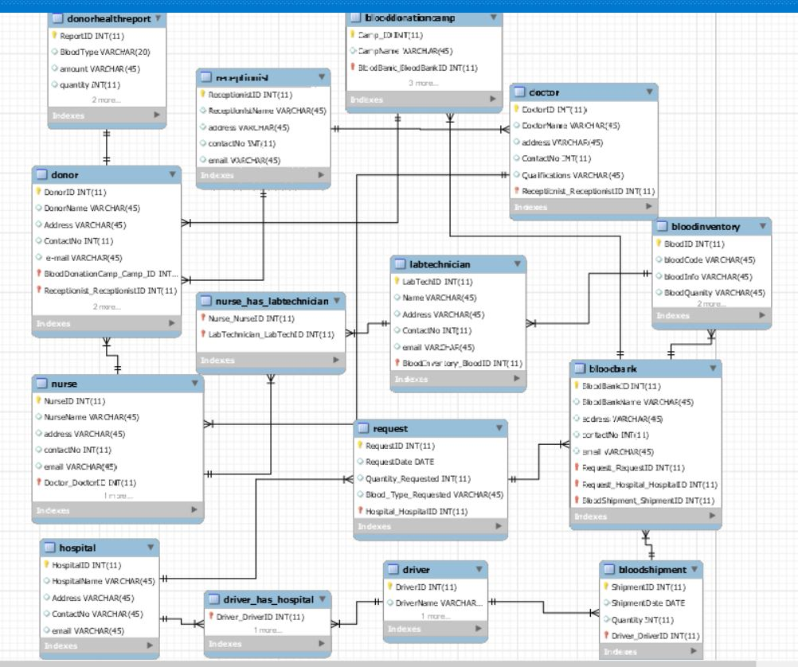
E-R diagram

Slide 5
The project covers : -
3NF Normalization
Joins
Subqueries
Triggers
Views
Procedures
Constraints

Slide 6
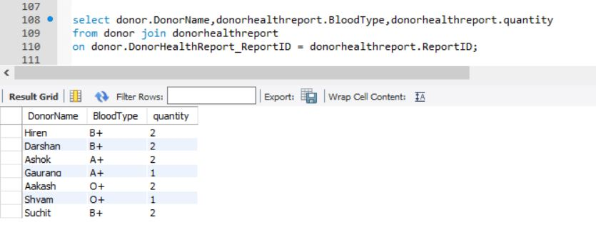
Joins(Donor Name and Donor Blood Details)

Slide 7
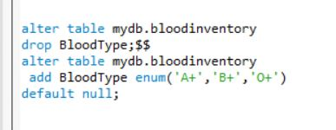
Constraints (for inserting values other than the spciefied blood group)

Slide 8
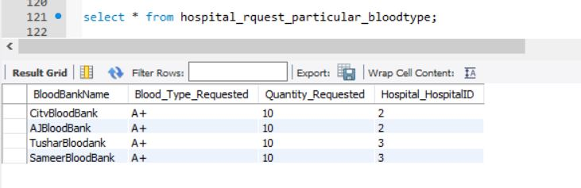
View for hospital request for a particular blood type : -

Slide 9
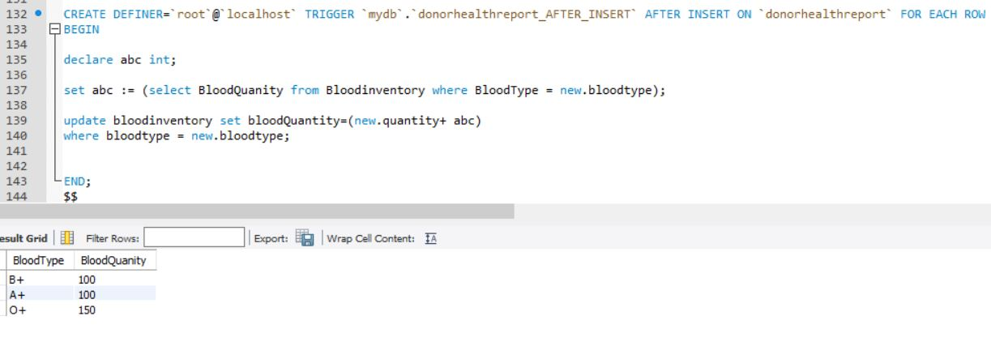
Triggers

Slide 10
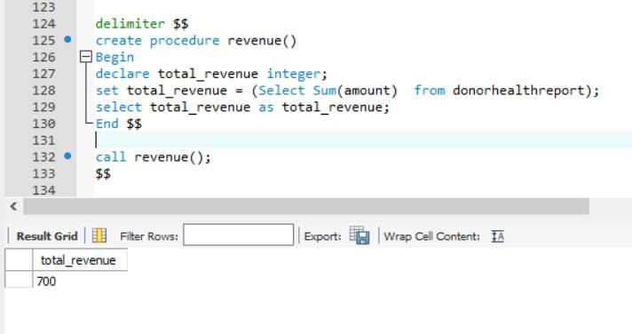
Procedure for getting total amount spend on getting blood by bloodbank camp

Slide 11
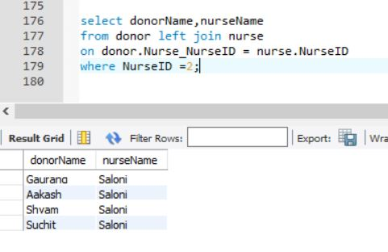
Left -Join for getting donors associated to a particular nurse (example of one to many relationship)

Slide 12
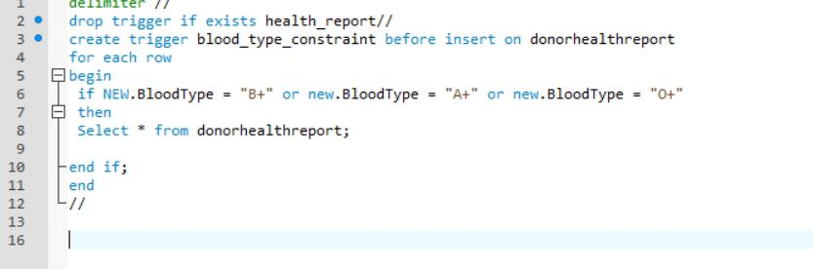
Creating a triggering constraint using if-else loop

